Slide 1
Image Processing on FPGA
Team ASMR - Aidan, Sophie, Muhammed, Robbie

Slide 2
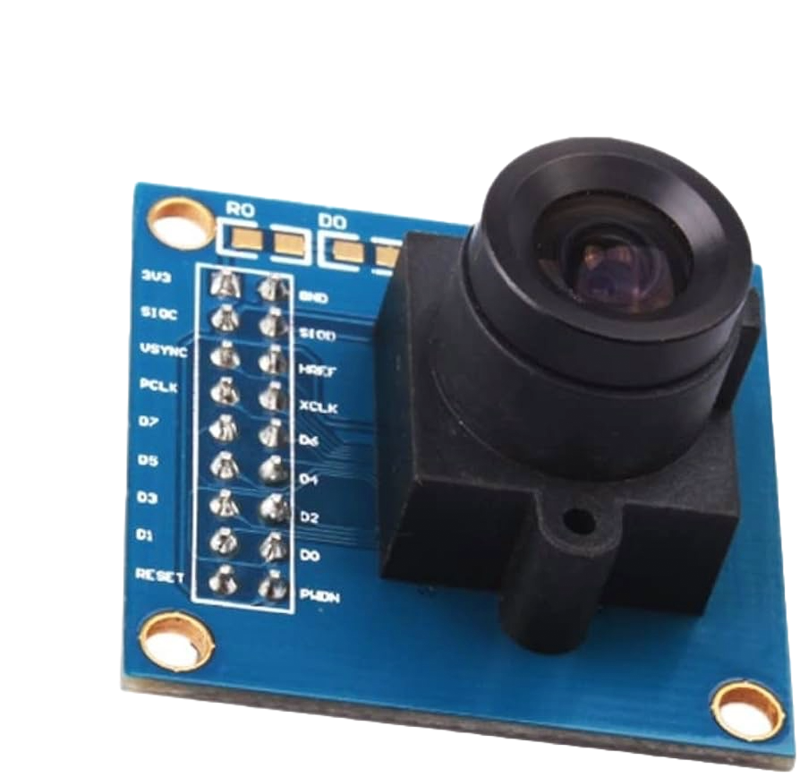
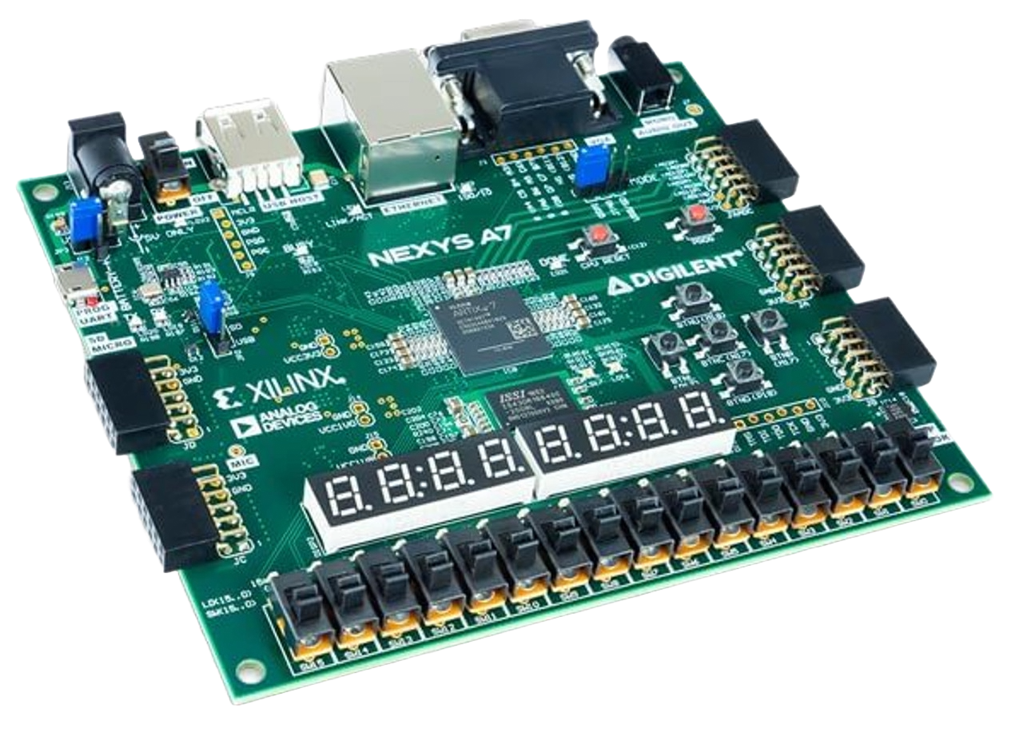
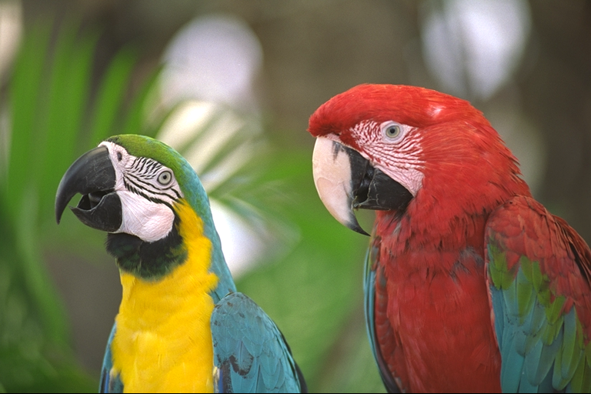

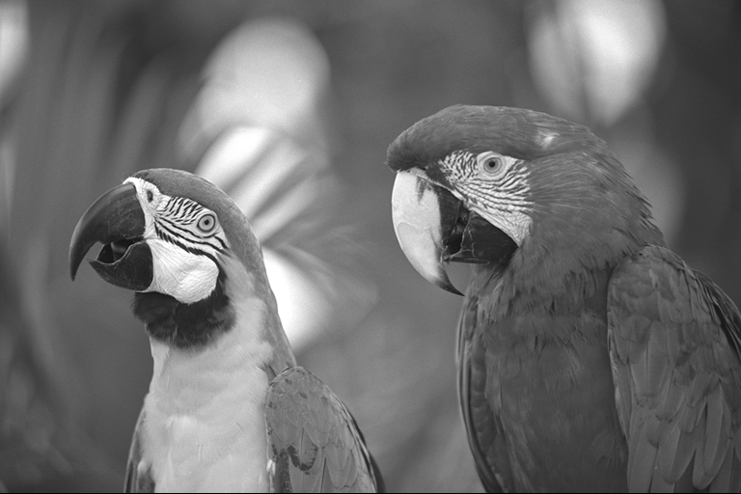
Our Project
Real-time image transformations and encryption on the Nexys-7 FPGA.
Desired Functionality:
Camera feeds in real-time video to FPGA
FPGA Switches are used to select between various transformations
Transformed image is outputted on VGA display

Slide 3
Why? (Goal/motivation)
Image processing has a variety of applications in developing technologies.
Pre-processed images can improve complicated systems/applications
It’s fun and interesting to play with image filters
Ex: Snapchat

Slide 4
Specifications
Ability to perform a variety of different image transformations
Frame-by-frame encryption
Integration with the Nexys-A7 FPGA

Slide 5
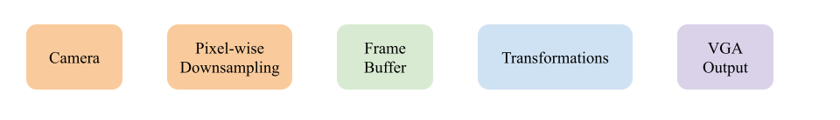
Detailed Functionality - Road Map

Slide 6
Step 1: Camera
Hardware: OV7670 Camera
480x640p RGB565 output (configurable)
Data output synchronized with camera’s clock
Driver code: Borrowed
Reads camera data one pixel at a time
We need to keep track of these pixels → Step 2

Slide 7
Step 1.5: Pixel-wise Downsampling
RGB565:
5-bit Red
6-bit Green
5-bit Blue
RGB444:
4-bit Red
4-bit Green
4-bit Blue
Q: Why do this?
RGB565 image is too large for block RAM
Nexys A7 FPGA has RGB444 VGA output
OV7670 configuration is confusing…

Slide 8
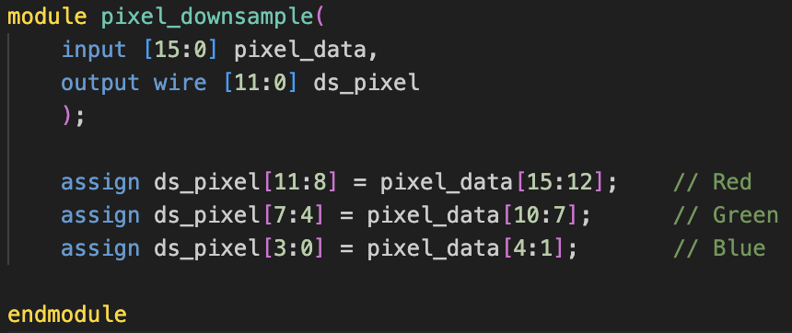
Step 1.5: Pixel-wise Downsampling
Take the four MSBs of each channel

Slide 9
Step 2: Frame Buffer
Why?
For transformations: Camera sends individual pixels, so we need to combine them to get the full image
For displaying image: Camera and VGA clocks run at different frequencies
How?
FIFO-style buffer
Use camera’s V-Sync output to differentiate between images

Slide 10
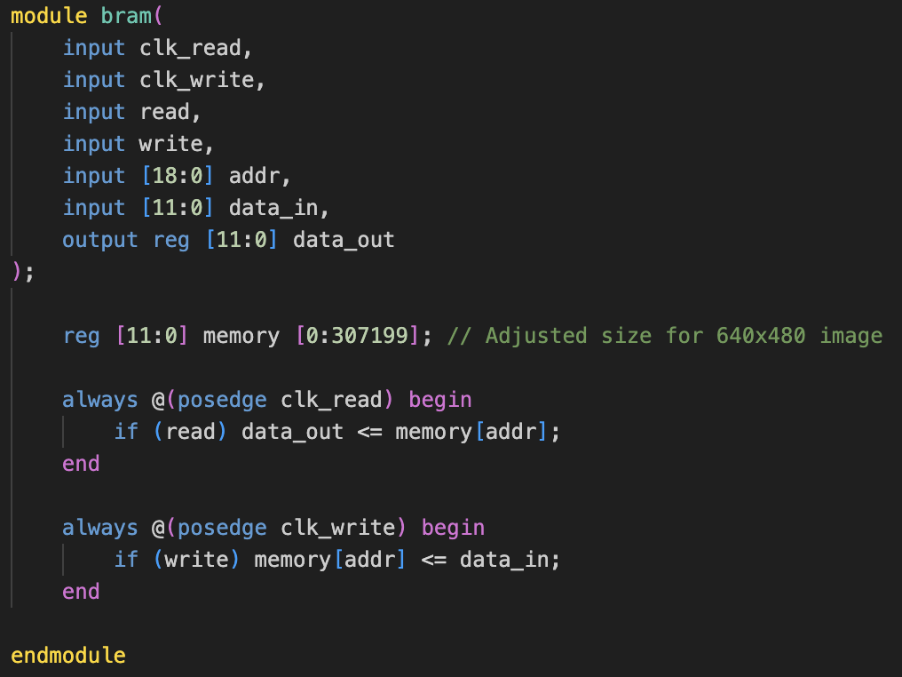
Step 2: Frame Buffer
Implemented as Block RAM
Need to access this B-RAM from multiple modules
Implemented bram module, which acts as an arbiter
Read and write synchronized to different clocks
Why B-RAM?
DDR is complicated
Provides (just) enough space for one image in RGB444

Slide 11
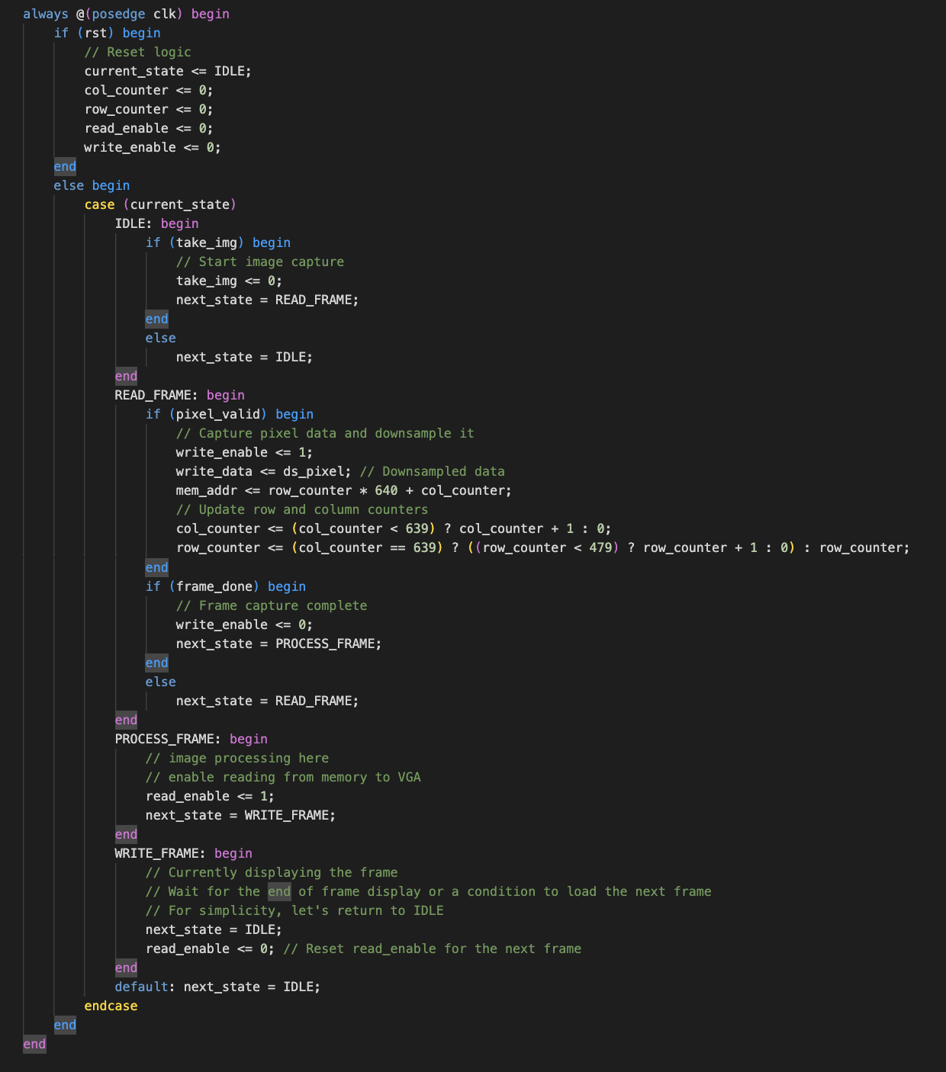
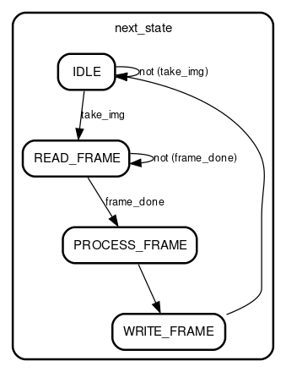
Step 2: Frame Buffer
Writing an image to the buffer:
12-bit pixel data is sent to frame buffer control FSM
Check if pixel is valid
If not, we’ll write all zeros
Check if image is done writing
If yes, move to state BUF_FULL
If no, address has been incremented and we continue the write operation
Synchronized to camera’s clock

Slide 12
Step 3: Transformations -- Simulation
Brightness addition
Brightness subtraction
Color inversion
Thresholding
Redscale
Greenscale
Bluescale
Greyscale
“Trip”
Blur
Sharpen (in progress)
Oil (in progress)
Notes:
Aidan

Slide 13
Step 3: Transformations -- The Simple
Notes:
Aidan

Slide 14
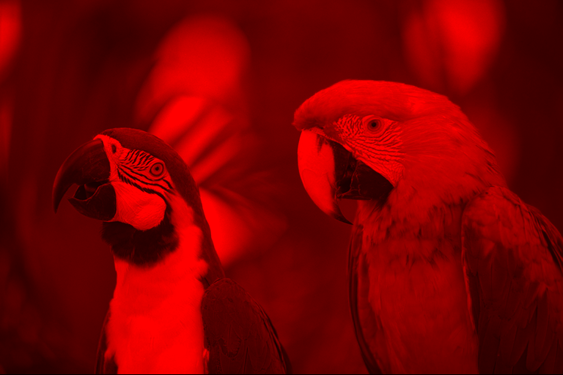
Step 3: Transformations -- The Simple
Notes:
Aidan

Slide 15
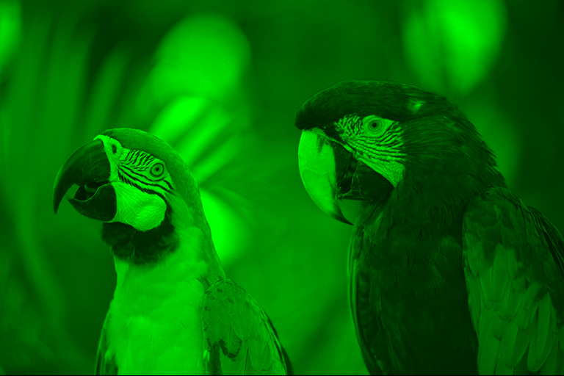
Step 3: Transformations -- The Simple
Notes:
Aidan

Slide 16
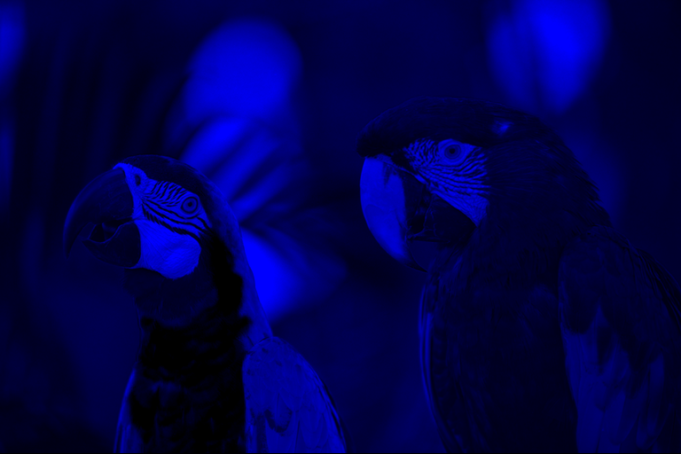
Step 3: Transformations -- The Simple
Notes:
Aidan

Slide 17
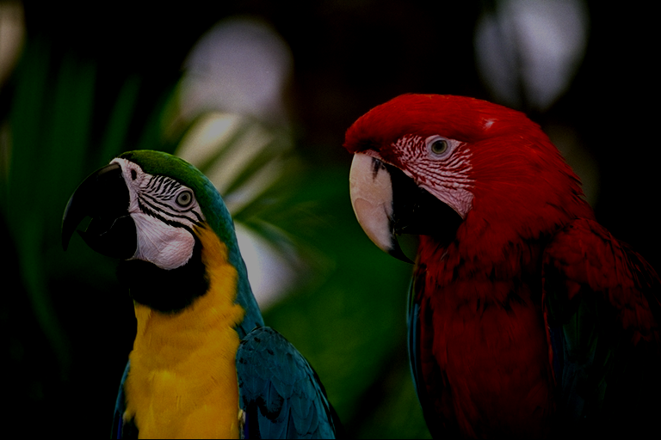
Step 3: Transformations -- The Advanced
Notes:
Aidan

Slide 18
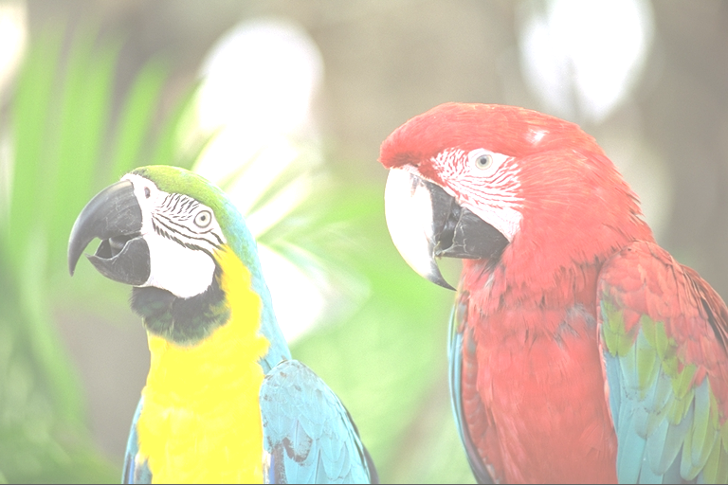
Step 3: Transformations -- The Advanced
Notes:
Aidan

Slide 19
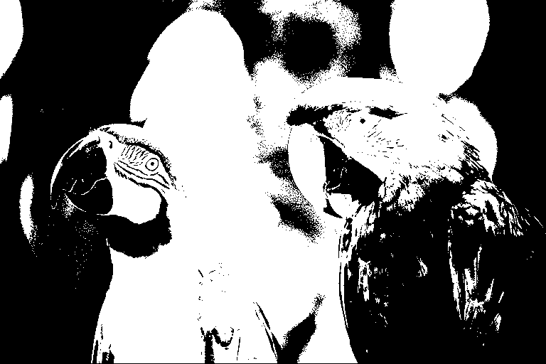
Step 3: Transformations -- The Advanced
Notes:
Aidan

Slide 20
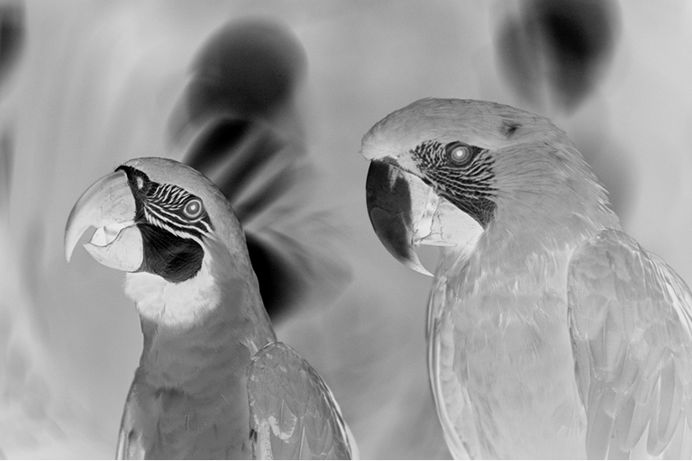
Step 3: Transformations -- The Advanced
Notes:
Aidan

Slide 21
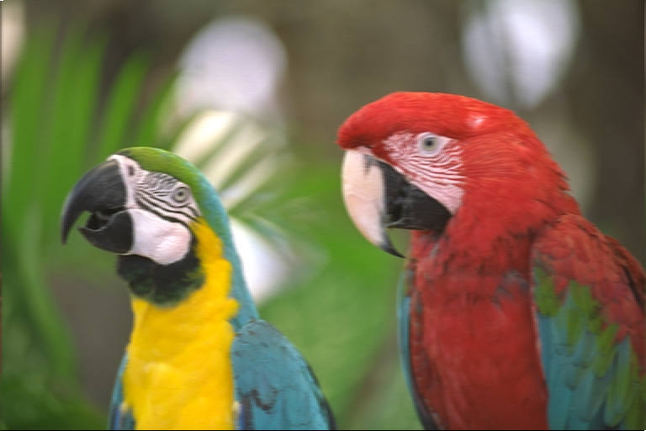
Step 3: Transformations -- The Complex
Notes:
Aidan

Slide 22
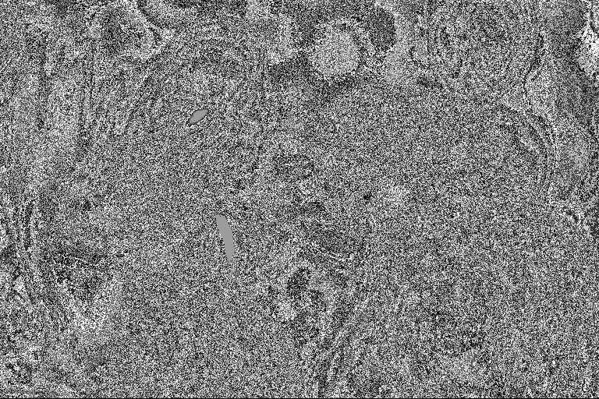
Step 3: Transformations -- The Strange
Notes:
Aidan

Slide 23

Step 3: Transformations -- The Strange
Notes:
Aidan

Slide 24
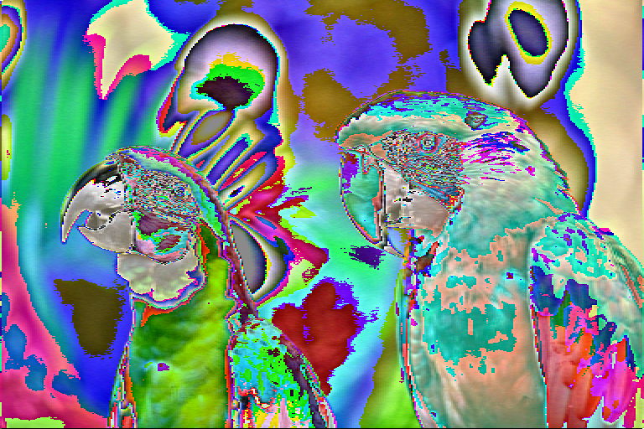
Step 3: Transformations -- The Strange
Notes:
Aidan

Slide 25
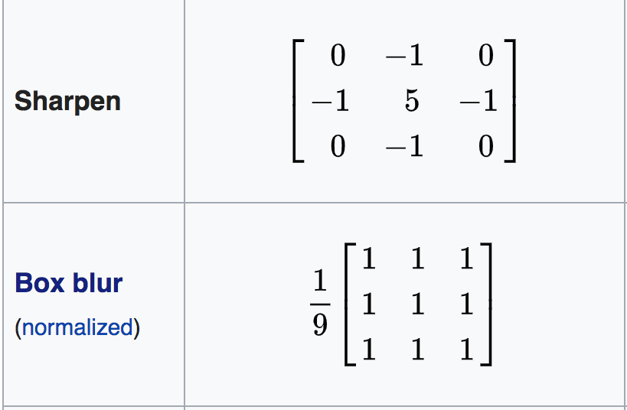
Step 3: Transformations -- Convolution Matrices
3 x 3 moving window frame operations
Account for nearby pixels
Can accomplish a variety of effects
Blur vs Sharpening
​
​
Notes:
Aidan

Slide 26
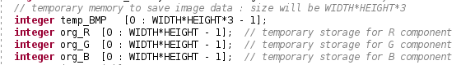
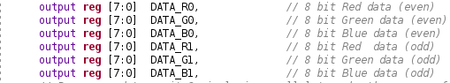
Step 3: Transformations -- Parallelization
Store image as a vector
Individual vectors of each
color
Can operate on multiple pixels
at a time
Can be scaled to handle more
pixels.
Notes:
Aidan

Slide 27
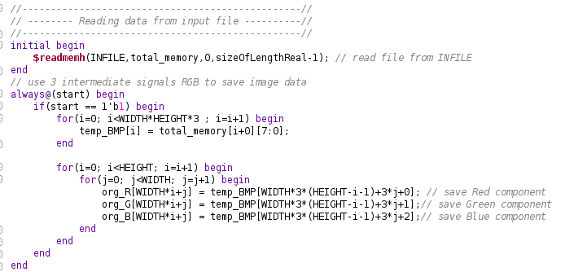
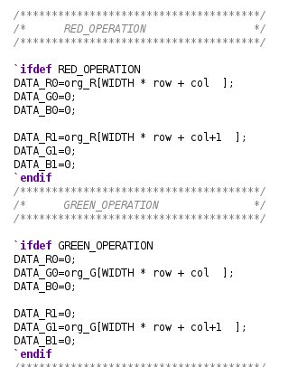
Step 3: Transformations -- Parallelization
Pay initial cost Later gains
Notes:
Aidan

Slide 28
Step 3: Encryption Module
Pseudo-randomly generate key
Same key to encrypt and decrypt images
Using different Symmetric key algorithms
Display 32-bit key on 7-segment display (8 hex digits)

Slide 29
Step 3: Key Generation

Slide 30
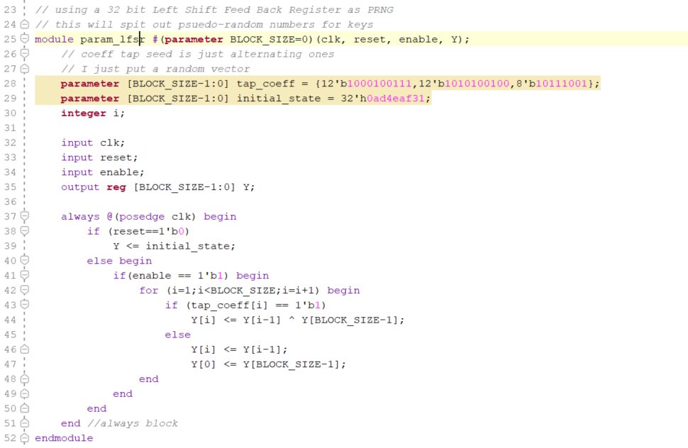
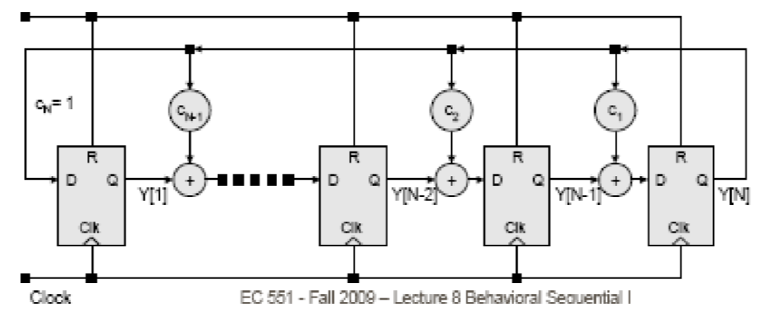
Step 3: Key Generation
From Lecture slides 13 implementation
Linear Feedback Shift Register

Slide 31
Step 3: Symmetric Key Encryption Algorithms
Electronic Code Book (ECB)
Simple
Parallel encrypt & decrypt
Repetition
Cipher Block Chaining (CBC)
Random Initialization Vector
Parallel decryption
Encryption not parallel
Key
plaintext
E(PT, K)
ciphertext
plaintext
E(PT, K)
ciphertext
Plaintext
Block 1
Block 2
XOR
XOR
Key
E(PT, K)
E(PT, K)
CT block 1
CT block 2

Slide 32
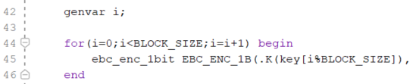
Step 3: Encrypting Images
When to read “plaintext” ?
Horizontal sync (hsync) signal
1 row of the image
Vertical sync (vsync) signal
Full image data
Storing temporary Data

Slide 33
Step 4: VGA Output
Driver code: part borrowed, part original
VGA operates with 25 MHz clock
Our task: read from bram, while coordinating HSYNC and VSYNC signals
Once entire frame has been displayed, send signal to clear frame buffer

Slide 34
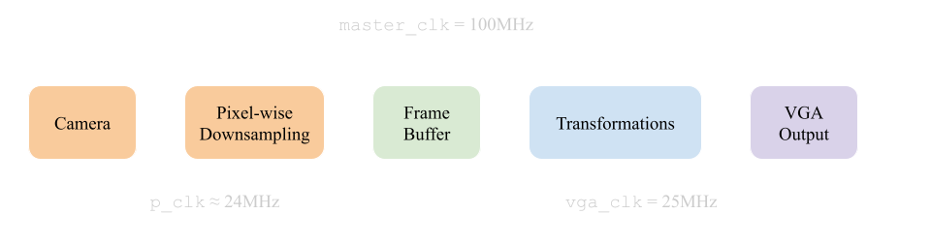
Additional: Timing

Slide 35
The Good
Many transforms have been implemented and are simulatable
Robust simulation environment to test a variety of transformations
ECB is implemented and is simulatable (one row)
Remaining FPGA I/O code is close

Slide 36
The Bad
Project does not yet run on FPGA
Anticipating significant debugging as we try to stitch all the pieces together
Difficulty implementing additional complex transformations
Sharpening and “Oil-painting” filter

Slide 37
Attribution of Work
FPGA I/O……………………………………………………………….Robbie and Sophie
Image Transformations/Simulation……………………………………………………Aidan
Encryption/Decryption…………………………………………………………Muhammed

Slide 38
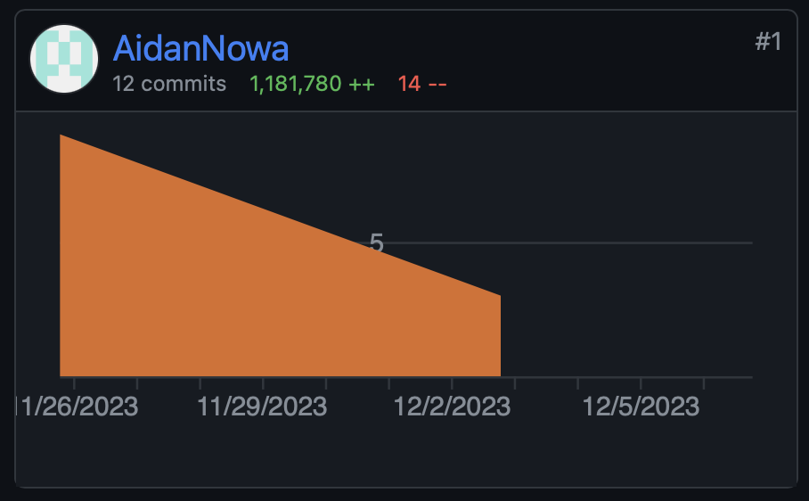
Honorable Mention

Slide 39
Questions?

